Slide 1
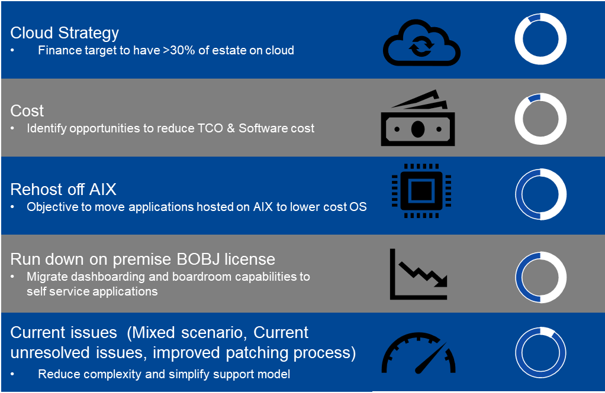
Executive Summary
What is SAP Business Objects?
The SAP BI Platform (BusinessObjects (“BOBJ”)) is a comprehensive BI solution with native integration to Finance’s Data Warehouse – SAP BW. The SAP BI Platform consists of many components, incl:
BI Launchpad
Reporting Tools(Webi, Analsysi for Office)
Dashboarding (Lumira)
Security
Governance
Monitoring and Auditing
Background
The current finance statutory, management, regulatory and operational reporting is delivered via the SAP Business objects suite, which is deployed on premise. The solution integrates seamlessly into the SAP BW Finance warehouse in terms of data and security concepts.
The current on premise deployment is deployed on AIX and Windows servers.
In line with the cloud migration strategy an opportunity was identified to transition the Business Objects estate to cloud.
The following options were considered for cloud deployment:
Managed service on SAP Private Cloud Edition hosted on a hyper-scaler
Azure Infrastructure as a Service with existing licenses
Business Case
Both cloud options provides TCO savings over the 5 year period evaluated. However, with the SAP PCE, in addition, the benefits of a managed service allows the bank to run down it’s existing business objects license model in line with the move towards SAP Analytics cloud, and provides an opportunity to significantly reduce shelf-ware license costs across the group.
Projected reduction in TCO:
Azure IaaS: R11 million
SAP Private Cloud Edition: R31 million
Drivers for migration to cloud
Approval Required
Approval is required to proceed with the deployment on SAP Private Cloud Edition.

